Slide 1

FBI
partner
development
1990 !41.CHECKPOINT CHARLIE, !PRESIDENT REAGEAN
INT.IPX; 1D8723
2005 INT.IPX (roth.ibm.daimler) 2010
HOMICDIE:GHOST(wake) HOMCI:ITALIEN:20
2005 PENTAOGN.roth.ibm.daimler.deere Middlefied Road, Moutain View, California
Blue Wedding Suite HOMCIE:CLEANER Latham Street, Moutain View
Assuemed; VIRIGINA.google
KING
Sky is grey
Gov.Schw(unimog)
WWI(Thomas-is-dieter).Gorbache(micheala)
ibm.daimler
ibm.daimler

Slide 2
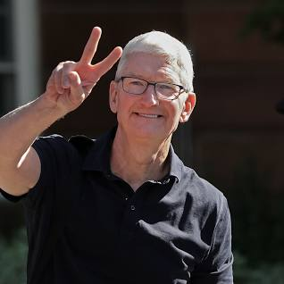
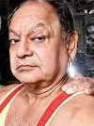

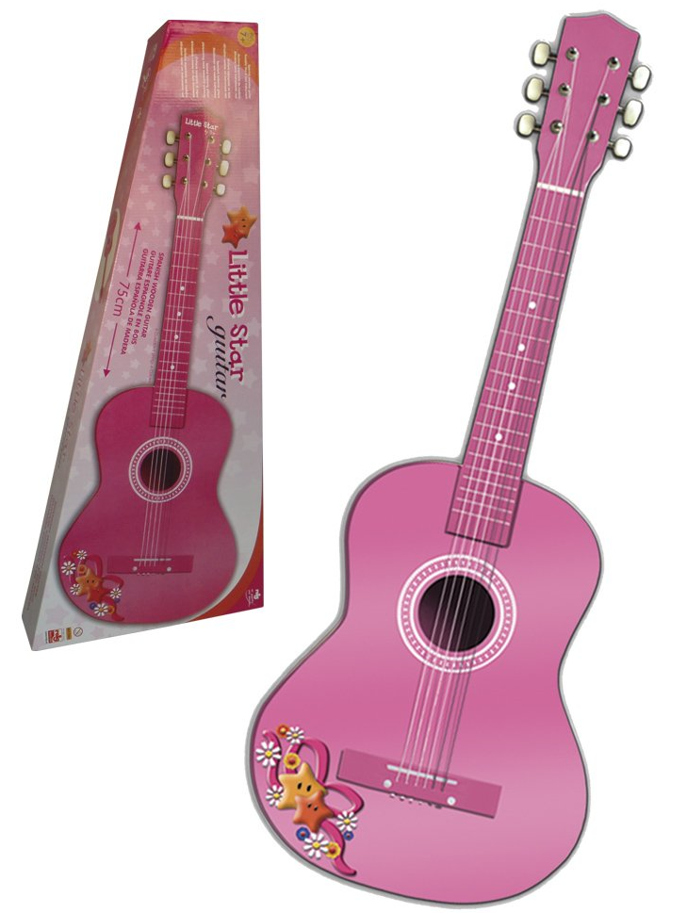
FBI
partner
development
2015 May
FBI:KIDNAPPING.v2
HOMCIDE:2Y, HOMCIDE:7Y
Birds Eye View
HOMCE:JEUSE:HOMCES:TANVEST
Moving services
!fag silent treatment.avg(nokia)
Tim cook, Steve Meiers;
Cypress Blvd, Oakley,
California

Slide 3


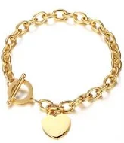
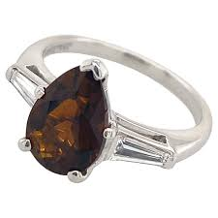
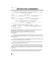
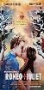

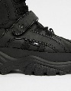
FBI
partner
development
God.Tunisian
.Parent.appel.damielr.marx(hellsangels).security
1997 September
G.MAINSTREET(SALES)
Move Out
Apple.davidon.marx(hellsangle)
Tom hanks completed
1980-1997
Id.parent: 500lbs/100lbs
130,000 DM
JFK.BULLET.24
0.01 fine ing/queen/jobs/jbos/meiers/meiers/meiers
41.JFK.MATHE.mAINSTREET((move the shoes
VP GERMANY.!JFK(Goethe,marco gheoh(heger a/e a/o))
J5
O
ATOMCLICK(HOMCIDE:AUSLAENDER.War in Yuglsalvia).Pope.!St. Ansleom.VIRNIG.AMRY(dr rice).son.marx(2pac)
not there; father

Slide 4
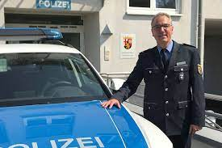
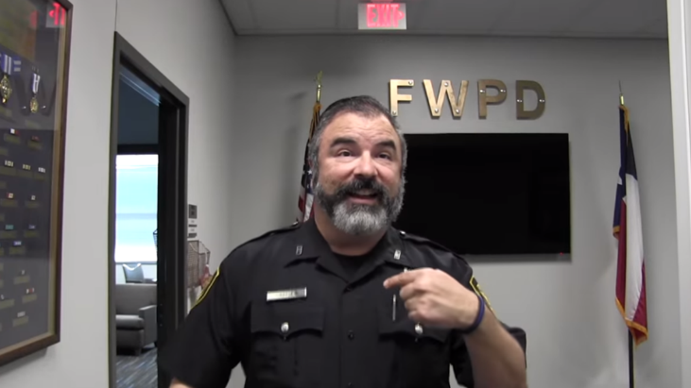
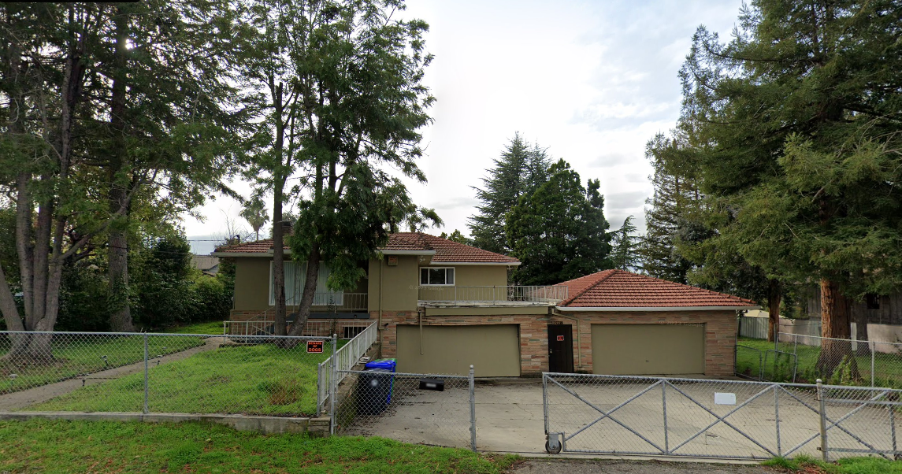
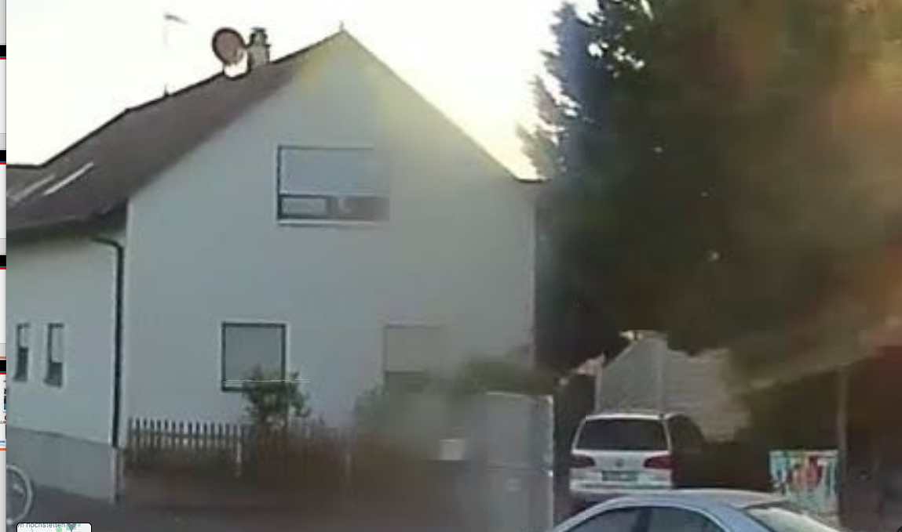
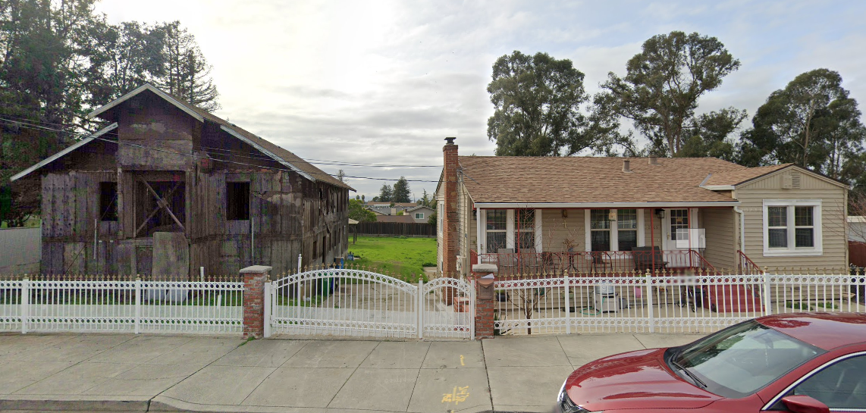
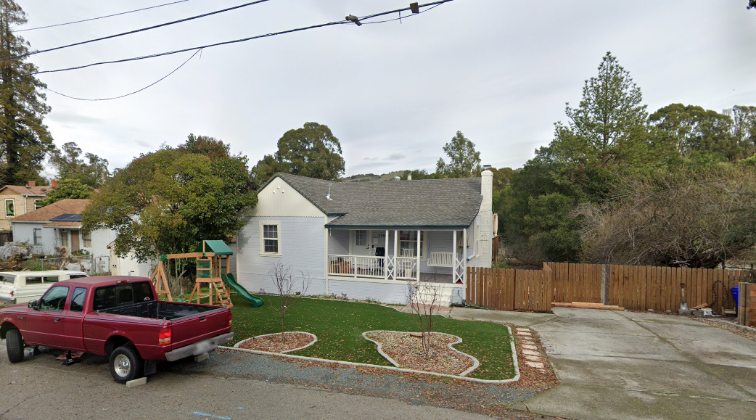
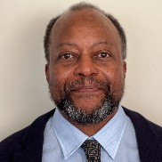
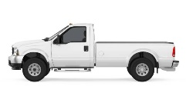
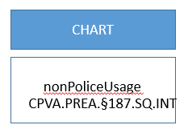
FBI
partner
development
1997 December
HOMICDIE:KYSTAL.lingusti(slanded driveway entry)
d
(“Move out”)
HOMIE:LUX.lsnti(shot in windows crysler)
MAINSTREET(haupstrasse
PAUL, 17(IPX[])
9-1-1
Call
CHART
ATOMCLOCK
nonPoliceUsage
CPVA.PREA.§187.SQ.INT
CPVA.PREA.§187.SQ.INT
Petersson
Church”Black”
Visa
Otis Morgan
Morgan Freman
SQ.INT.IPX.FBI.INTESTING(chales manson)
Hells angele sonny berger, carbolaouge
PENTGONA.BASE.MANNHEIM.COLEMAN
[x] no
[x] no
!41.PREA

Slide 5
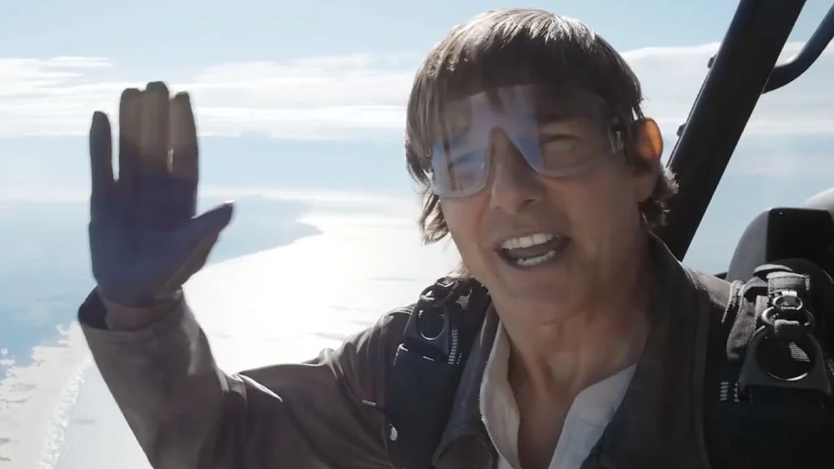

FBI
partner
development
Stanford
Angel Merkel
Michekal Gorbachev
PENTAGON.VIRGINA.MARY
Achim, Arim, Dr. Profl Joachim Zahn, Daimler Ag
- Immate studies langues in 1994, transfer soul
1995 GAS(Rudolf-diesel-strasse)
Gorbache(dell.cleint.uhse.(beathe)
9-1-1 Flights
HOMCE:LUX:COINTWON(brucsal,munsezshiem)
Daimler Ag
Dr. Dieter Zehce
TUI/L’t Meiers Weltreisen,
Deutsch Reeisbuerk Karluerhe
Adolpf Hitler/Eva Bran-Vera Braun
Batman?
Beate: - Keih leget dies on set

Slide 6

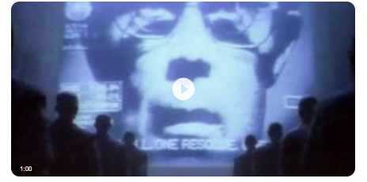
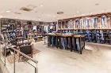
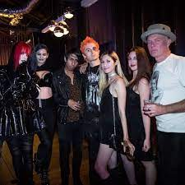


FBI
partner
development
1997
HOICME:LUX(gheoh(eiscaking, docs) Patatu shoes
docs
Seriel Killer 1 and 2 not 3
Note: Group of Seriel Killers
Recylig.pms.”silver surfer”: soul
WWI(Jerome).K-TOWN
!fag.boyfriend HOMCIE:TRANVETITE(IPX hard.41) HOMICDIE:JESUS
MATHERE: they killed him: 41.ASSAULT.STALKING.WWI.HOIMCE:JESUE[apple]
41.JFK.MATHE.mAINSTREET((move the shoes
VP GERMANY.!JFK(Goethe,marco gheoh(heger a/e a/o))
J5
O

Slide 7
FBI
partner
development
2010 !PRIVATE.41
PUBLIC
Grobachev(Visa France )
nonPoliceContentItems
!AVAILBILITY.
!IN
nonPoliceContentItems
INTERNET PAYMENTS
FACEBOOK
0.1 click I want to show
0.1 runner gheoho(tyson,mike, visa.planspna)
0.1 fast do that anywy
PUBLIC risk STANFORD:visa McCarty visa risk,pmp
SQ.PREA.187 (keepalive)

Slide 8
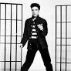
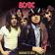
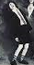
FBI
partner
development
Elvis
KING.JFK(bruce)
HEOMI:AULAENDER.achso.marx(elvis)
CPVA
Band: Wonderbras
Linkeidn: father impsonator
Father: avg
Stanford
nonPOlcieContnetItem(chruchlill,bathtub)
1993/4
000.
PENTAGON.BASE.PAUL.
LOVALCE.TV
41.2009 Food, Eva Braun Person Brings food to phonogyrphy studio
I5 SF-LA
Fart: Motel 6, mother in law , anal 0.1s snoop doggy dog long beach
Fart: Logicl: Disneyland SQ.CDCR.jimmuy
Billy madison
2010 KING.QUEEN.WORMS(bismarkstrasse): highwaytohell
0.1 turning music before starting to work on long project task

Slide 9
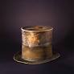
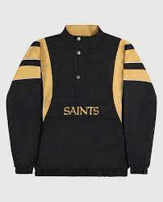
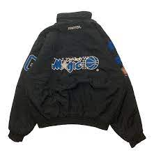
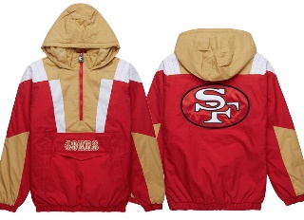
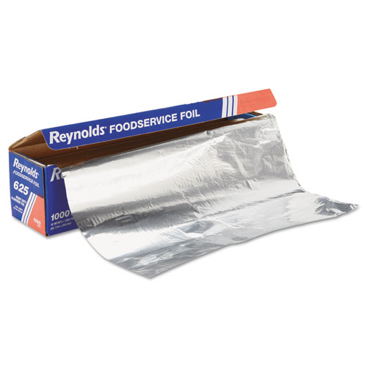
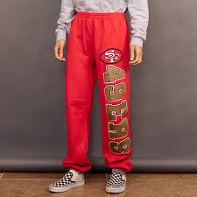
FBI
partner
development
Thoams-is-dieter: Down th chimney
Music: Standin at wall in discothek
POLICE:FORT:WORTH: Up the chimney(hand)
¼-de gheo(dr).TERMIANATO.JOEPHSE
gheoh(dj). J5/C5 (ext.gorbachev.remote)
1995/6
Mark(Jackok): foster (blond)
Thoams-is-dieter: Down th chimney
jochen(breadle):
NSA.nonPolcieTexasLogialCfg (tnral) little fire
“busted” Chairment China
Foster City
Vw[green]
IPX WWI. Ass tattoo male, jochen2
000.PENTOGN.LOVELACE
twins
1993/4 7th, 8th
000.PENTOGN.LOVELACE
SQ.INT.HOMCIDE:2Y.St. Franci.anglea.8th floor
Angela-o
1993 VIRING.MARYT(
renolyds)
SQ.MANNHEIM.PENTOANG.ALUIMINU
Ikea kithce top refrigerator, Pengaton Ikea kitche (father)
PENTGON.PAUL.BARA.ALUMINUE “renolyds”
1990

Slide 10
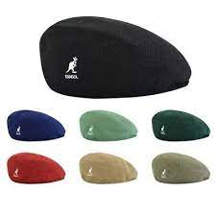

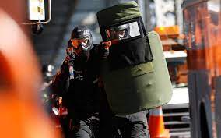
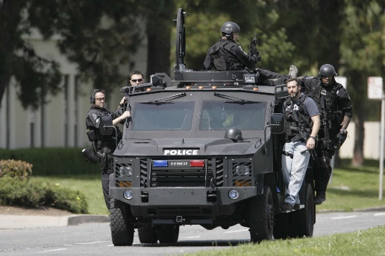
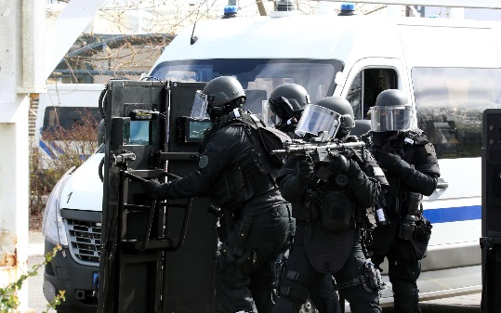
FBI
partner
development
Thoams-is-dieter: Down th chimney
Music: Standin at wall in discothek
POLICE:FORT:WORTH: Up the chimney(hand)
¼-de gheo(dr).TERMIANATO.JOEPHSE
gheoh(dj). J5/C5 (ext.gorbachev.remote)
Thoams-is-dieter: Down th chimney
Thaosm-is-dieter: jetz geths ab
Roment docs(tim cook) Romans
1996 7ft girlfdin travel (looking)
Runny noise(blond)
Mark(Jackok): foster (blond)
Sitz of dem trokcenne: w/o cannibs
Pope.(roemle, german teacher) canou
HOMCE:LUX:COINTOWN:HATEHOLE.St. Nick transfer DEA(orage cannibal glowing)
ROMANS
Police Swat
IBM Swat Oakland W/SAM
41.alg.nonPoliceRomans{
}
TERMINATOR:JOEPHSE
!go outside and be jesus asshole

Slide 11

FBI
partner
development
1990 CHECKPOINT CHARLIE HOMICIDE:NANA “LINK”
1990 !HOMICIDE:MAYRO(katy boden,johs)
2000 HOMCIE:MAYOR
2005 IPX “LINK” Ghost
2010 IPX “LINK” Italien
Dev SF modesto, gheoh(micheala).MATHEW
The truth
“Bejamin[] Franlin:HOCE:LUX;brushini”
Flicker
No smoking
1997 !JFK(vp Germany)
Put thos shoes outside
Phantom:HOMICIDE:LUX.VIRINGAI
Phantom:FORT WORTH
de
1997/8 MAINSTREET(HOMESIDE:JESUS(lutz))
1997/8 MATHEW: HOMCIDE:TRANVESTI
Newark, Califnia apple.steve.PAUL.speaker.41.Mexican gans newardk
HOMVIDE:LUX:VP GERMAN.INTERTUP.goth: operat phaot goth dgheoh(dj)
1997/8
IPX suicide
MAINSTREET(de)
1990 CHECKPOINT CHARLIE
1997 IPX “LINK” JESUS
1997
us
Us: HOMCE:TRANSVESTITE
ibm.damiler
Confirmation: (roth(ibm.damiler) us-de
2010 IPX “LINK” Italien
HOCE:LUX;brushini
HOMC:PETER (self inflicted)
(Bindings) soviet apple
ibm.damiler
Ejb bindings dr zimman(HOCME:JESUS)
ibm.damiler
ibm.damiler
Apple.division.marx(hells angel)
1997
1990 CHECKPOINT CHARLIE HOMICIDE:NANA “LINK”
1990 !HOMICIDE:MAYRO(katy boden,johs)
2000 WAR
“LINK” JESUS
2005 IPX “LINK” Ghost

Slide 12
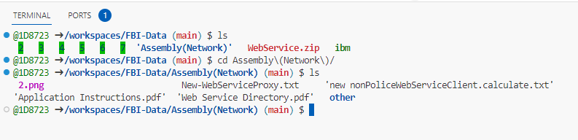
FBI
partner
development
ibm.damiler “LINK”(IPX)
CONFIDENTIAL(SECRET)
2 secd HOMCE:S_a-BELL(sovet union,basf)
Gheoh(dr, Zimmerman, j2ee).PETAGON.HOMCID:JOERG.rmi-ejb-iiop
DE-US !CONSTUTION
What ties them together
Enterpris (bidings)
Ibm.damiler
Ibm-dos: configuraiotnmanagment; he added usage
she add ussa POLCIE DOS
Denail of serve attmeth (configurion) - Fricton
12:35 Police Sirens
FRICTION
ibm.damiler
Apple.division.marx(hells angel)
2000 WAR
1990 !HOMICIDE:MAYRO(katy boden,johs)
MIAMI 2007/8
0.1 appe.touch.grenstmpe.HOMIC:JESUSS(pojo.!enterprise)
Facebook.!AVABILTY
Stepnaie: she did overwheight
AUSCHIET:HOCMELUX(tiwns)
Boyfrind CA long hair
!WWI soviet hells angels bindins
The person died later, is used for binding US-DE
2000 WAR(kriestrasse)
HOCE:LUX;brushini
HOCMI:IS-A-BELL(basf cheimices: ejb )
ibm.damiler
2010 IPX “LINK” Italien
HOMC:PETER (self inflicted)
(Bindings) soviet apple
ibm.damiler
ibm.damiler
Ejb bindings dr zimman(HOCME:JESUS)
1997
“LINK” JESUS
2005 IPX “LINK” Ghost
0.1 al kaid nonPolizeiHAMBURG.PENTAGON.emea dr zimmean High level
Polc Sirens: 12:50: High Level Library, Documetns Applction, WebSEr,Neworking; Polcie Sirent(stop) Firetruck
Notes:
x/y Library to Court Librayr .nonPolicCfg(wiring)

Slide 13


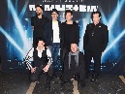
FBI
partner
development
WAR.§Abortion Merkel, HOICM:STILL:LUX:BORN[]
WWI.41.Volvo drop ass at Kaiser, eni/andrea oakland
JFK(bruce)
TORT-1.ibm.employe.arul.raj
TORT-1.DEA(herion)Cake eater(stopper)
AUSCHWITH die best sterben jung (tnral) the best die young
nonPiceAttments.HOMCE:MAYOR
8/1/2023
2010 INTENET PAYMENST HOMICE:LUX:HATHOLE.St. Nik JFK(worth, david)
41. Drunk at comptuer
Moutain View, Calfnora
Eric.ludwith.wait
IMPORT ATOMLCOK(time ).MILTIARY
Raik!
o
Pope.St. Nick.VIRGINA.MARY(recyling at glu toilet nrear maginiant (acctuant) and chineen eigneering accoutaints)
asuemd 41 unknow HOMC:LUX:CONTIN:INTENRTOWN collections

Slide 14
FBI
partner
development
L3 - Marty stevear
nonPolcieLanauge.add.linstia(local)
Alg.phil(kim)
41.ibm.l3 Hercules choy
!swat l3
l3
Arhtush Tshang
41.ibm.l3 Hercules choy
Arhtu thsas (swat)
Artun damiler Gov. Schw. Fron gate9artu
Thaomie-is-dieter

Slide 15
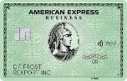
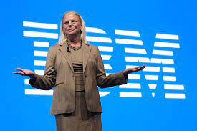
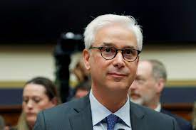
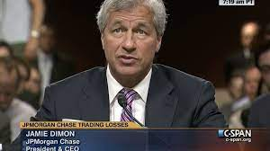
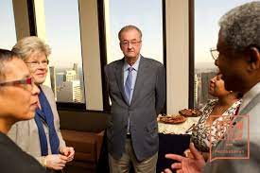
FBI
partner
development
ROMANS
Logical
Police Swat
IBM Swat Oakland W/SAM
41.alg.nonPoliceRomans{
}
TERMINATOR:JOEPHSE
!go outside and be jesus asshole
41
Invert !HOMICDIE:JESUS
!HOCME:PETER
ATOMCLOCI(
V2.sheep
).CPVA
CHART
dtcc
41
Avg.nonPoliceUsage
FORT WORTH chruch
Logical
41
GodFather
0.1 who is help you –gorbache(micheala)

Slide 16
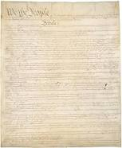
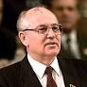
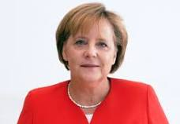
FBI
partner
development
ROMANS
Police Swat
IBM Swat Oakland W/SAM
41.alg.nonPoliceRomans{
}
TERMINATOR:JOEPHSE
!go outside and be jesus asshole

